Slide 1
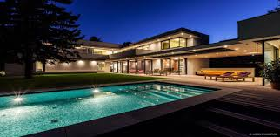
Melbourne
Property Market
(2016-2018)

Slide 2

Franco, Joseph, Catherine, Nasrin Group #3

Slide 3

Main Questions
Distance from CBD
Crime rates
Schools
Train Stations

Slide 4
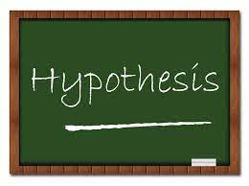

Slide 5
Hypothesis 1:
The distance from CBD has direct correlation to the housing price.
The nearer to the CBD, the higher the house price.

Slide 6
Hypothesis 2:
Crime Rates will affect the house price in the suburb negatively.
The higher the crime rate, the less likely the house price will increase.

Slide 7
Hypothesis 3:
The school zone area is one of the main reason for the surge in house prices of specific suburb. Both private and public school play a big role when it comes to choosing the right suburb to live in.

Slide 8
Hypothesis 4:
The nearest to the train stations has a direct effect on the house prices.
The closer to the train stations, the higher the house prices.

Slide 9

Datasets

Slide 10
Sales of houses in Melbourne
List of all the schools in Melbourne
The crimes rates in different suburbs
The train stations info
All in csv formats
The age of the data from 2016-2018
The market fluctuations cause of COVID after 2018

Slide 11

Hypothesis 1

Slide 12
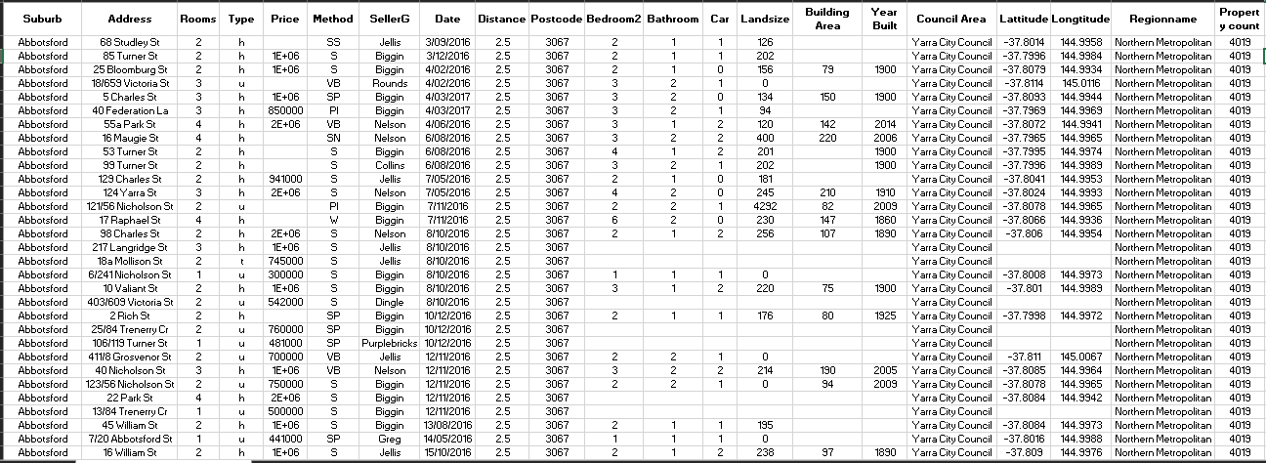

Slide 13
Row Numbers: 34857 Suburb Numbers: 345

Slide 14
H0 = There is no difference between avg house prices and different distances from CBD. H1 = The avg house price in closer distances from CBD is higher.

Slide 15
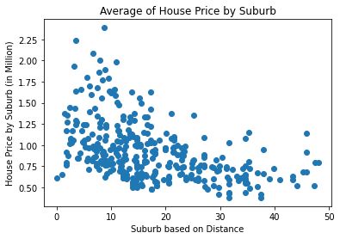
All house prices in all suburbs
Correlation Coefficient : -0.46
0.3 <r <0.5 => Weak Relationship

Slide 16
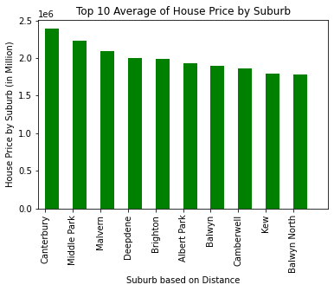
Top 10 highest house prices by suburbs
Downward Trend

Slide 17
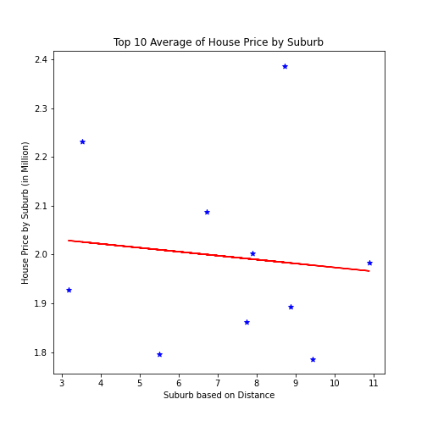
Top 10 highest house prices by suburbs
Y= -0.01 X + 2.05
Correlation Coefficient : -0.46 <0.5
P-value: 0.77 >0.05
(H0) is approved

Slide 18
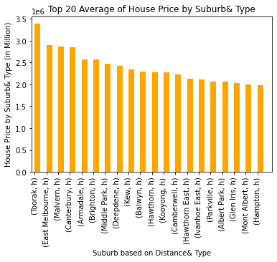
Top 20 highest house prices by suburb& type
Downward Trend
Just “h” type

Slide 19
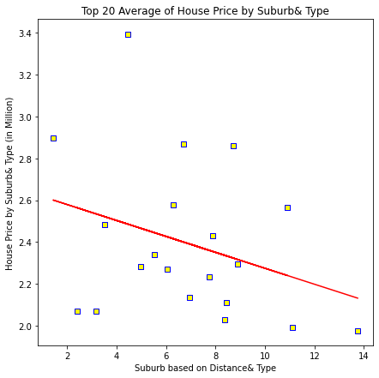
Top 20 highest house prices by suburbs& type
Y= -0.04 X + 2.66
Correlation Coefficient : -0.31 <0.5
P-value: 0.17 >0.05
(H0) is approved

Slide 20
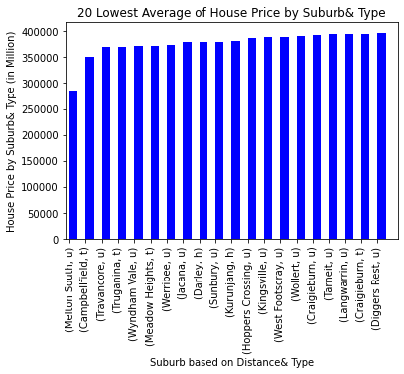
20 lowest house prices by suburb& type
Upward Trend
Most of them “t” , “u” type

Slide 21
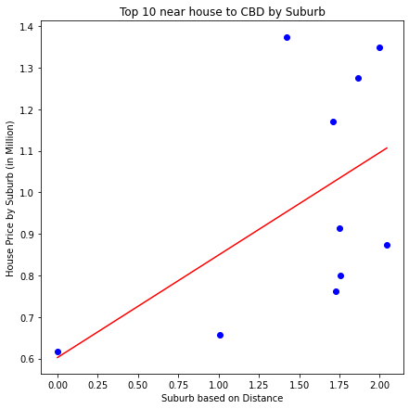
Top 10 nearest house to CBD by suburb
Y= 0.25 X + 0.6
Correlation Coefficient : 0.53 >0.5
P-value: 0.11 >0.05
(H0) is approved

Slide 22
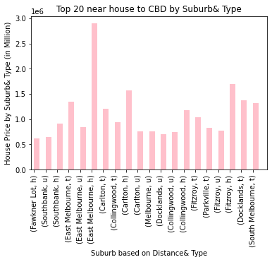
Top 20 nearest houses to CBD by suburb& type
Upward Trend
Different kind of “h” , “t” , “u” type

Slide 23
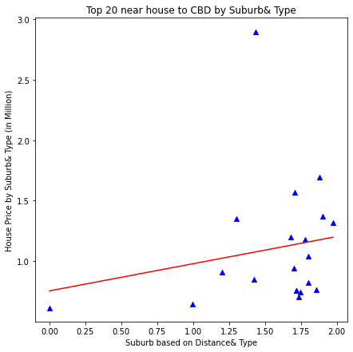
Top 20 nearest houses to CBD by suburb& type
Y= 0.22 X + 0.76
Correlation Coefficient : 0.19 < 0.5
P-value: 0.42 >0.05
(H0) is approved

Slide 24
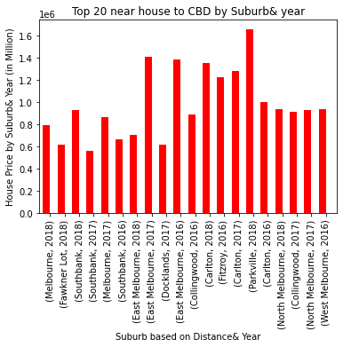
Top 20 nearest houses to CBD by suburb& year
Upward Trend
Mostly from 2018

Slide 25
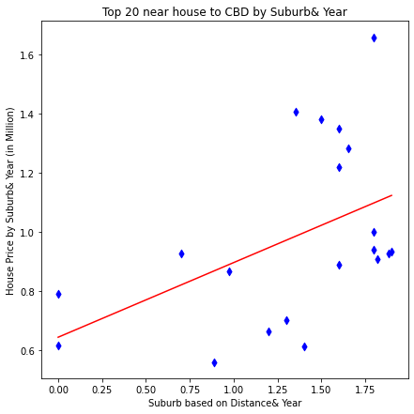
Top 20 nearest houses to CBD by suburb& year
Y= 0.25 X + 0.64
Correlation Coefficient : 0.47 < 0.5
P-value: 0.03<0.05
(H0) is rejected

Slide 26
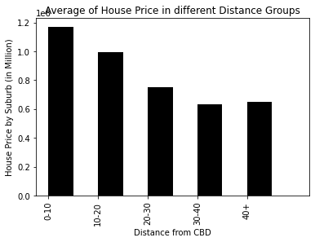
Average of house prices in different distance groups (bins)
Downward Trend

Slide 27
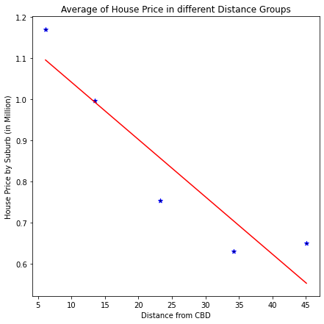
Average of house prices in different distance groups (bins)
Y= -0.01 X + 1.18
Correlation Coefficient : -0.93 > 0.5
P-value: 0.02<0.05
(H0) is rejected

Slide 28
Conclusion for Hypothesis 1:
The negative relationship between the average of house price and different distance groups
in Melbourne
.

Slide 29
